Slide 1








VORTEXA
3.0
12 HRS HACKATHON
POWERED BY A.I.R.S
DOMAIN & NO : 5, E-02
PROBLEM STATEMENT TITLE :
CodeQuest AI: AI Coding Mentor & Debugging Missions
TEAM NAME : Indicoders
TEAM ID : VTX26-90393

Slide 2



PROBLEM STATEMENT
Coding is easy to start. Debugging is hard to master.
Confusing Errors: Beginners struggle to understand compiler errors and failed test cases.
Solution Dependency: Existing AI tools can encourage copying code instead of understanding it.
Lack of Personalization: Learners receive limited guidance based on their recurring mistakes.
Learning Gaps: It is difficult to track weaknesses and measure actual skill improvement.
Core Problem: Students need guidance that helps them understand and solve coding problems independently.

Slide 3
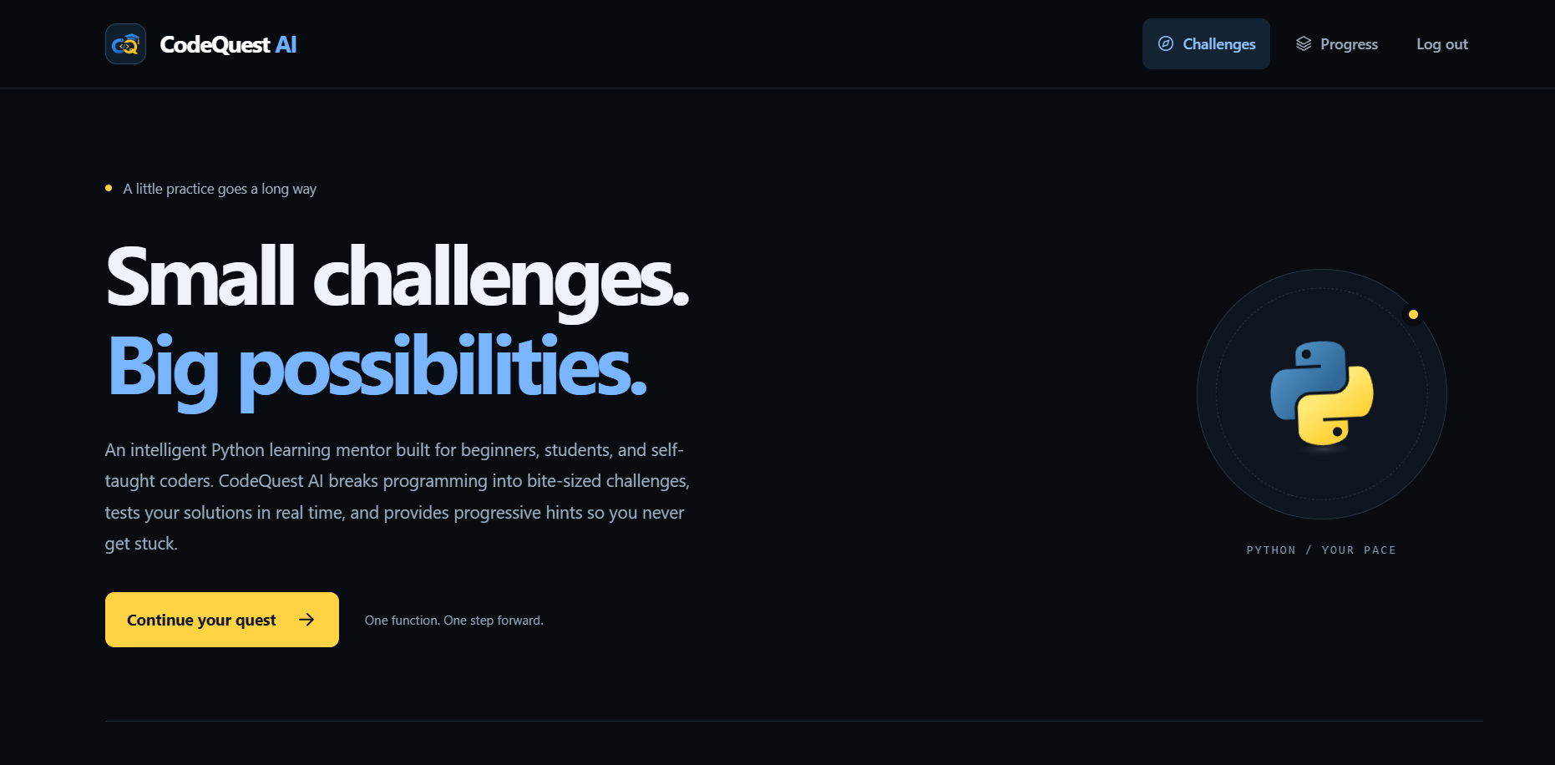
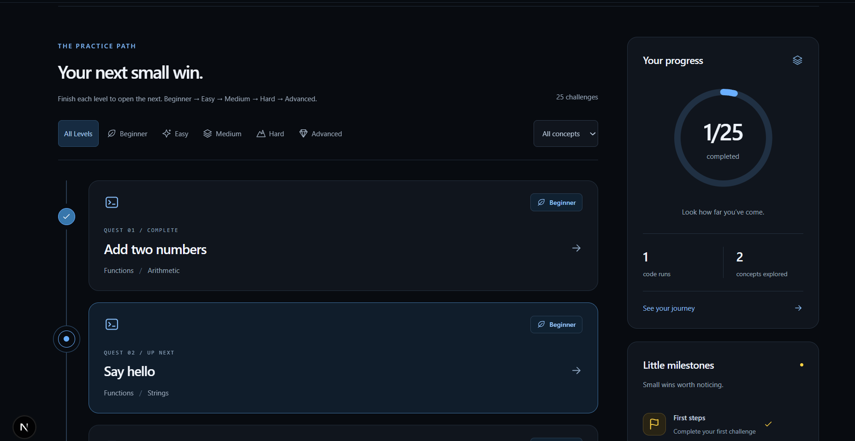
IDEA TITLE / PROPOSED SOLUTION
CodeQuest AI — AI Coding Mentor
CodeQuest AI is a proposed beginner-friendly coding platform that guides students toward understanding and fixing their own code.
How it works:
Select a coding challenge and write code.
Run the code and inspect errors and test results.
Receive progressive hints:
- Level 1: Conceptual Nudge
- Level 2: Focused Direction
- Level 3: Specific Debugging Guidance
Fix the code independently and try again.
Track recurring mistakes and receive targeted practice recommendations as a planned feature.
Don’t just fix the bug. Learn how to think

Slide 4
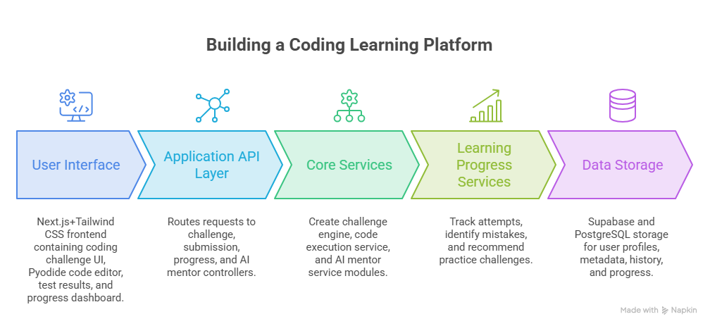
TECHNICAL APPROACH
Frontend/Application
Next.js
Tailwind css
Pyodide (code editor)
Backend & Deployment
Supabase with PostgreSQL
Vercel – Deployment
Python
FastAPI
AI
Gemini API (AI mentor)
Codex
Antigravity

Slide 5
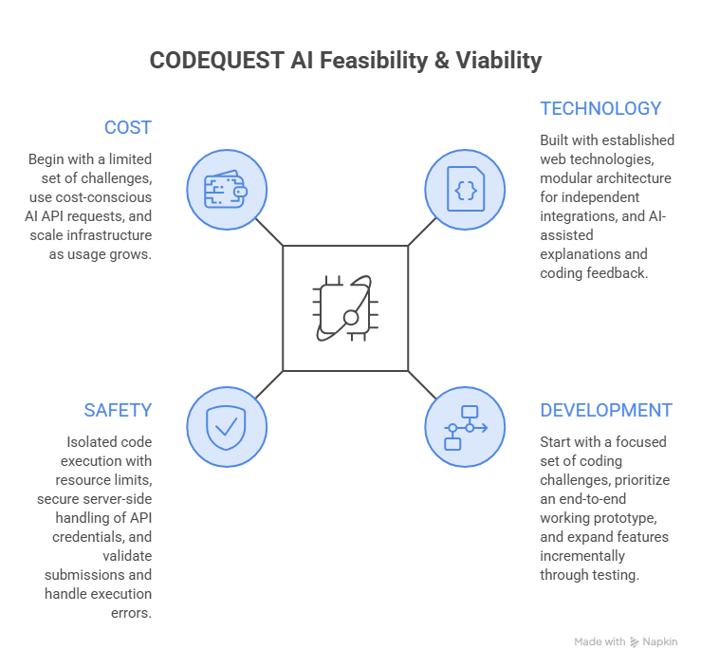
FEASIBILITY AND VIABILITY
Practical to build. Flexible to scale.
Technical Feasibility
Built using established web technologies and modular components.
AI and code execution services can be integrated independently.
Implementation Feasibility
Begin with a focused set of programming challenges.
Prioritize the complete cycle of coding, testing, and receiving feedback.
Safety & Reliability
Isolated code execution with time and resource limits.
Server-side API key management and controlled service access.
Economic Viability
Start with a limited challenge set and cost-conscious AI usage.
Expand capabilities as usage and resources grow.
Potential Users: Students, coding clubs, educators and self-paced learners.

Slide 6
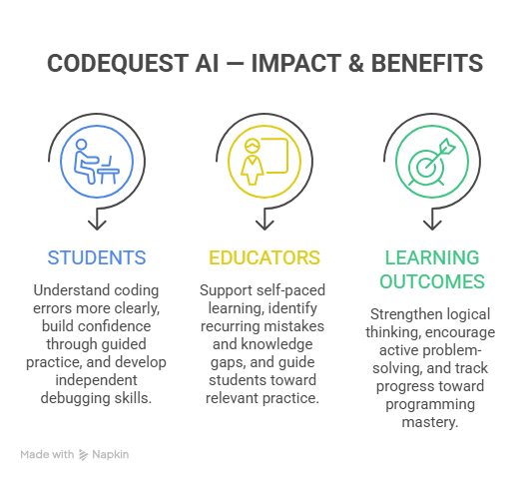
IMPACT AND BENEFITS
From debugging frustration to independent problem-solving.
For Students
Understand errors instead of blindly fixing them.
Build confidence through guided practice.
Strengthen programming fundamentals.
For Educators
Support self-paced learning.
Identify recurring mistakes and areas requiring attention, where progress tracking is available.
For Learning Outcomes
Encourage logical thinking and independent debugging.
Make coding practice more engaging through challenges and milestones.
Long-Term Vision: Make personalized programming guidance more accessible to every learner.

Slide 7
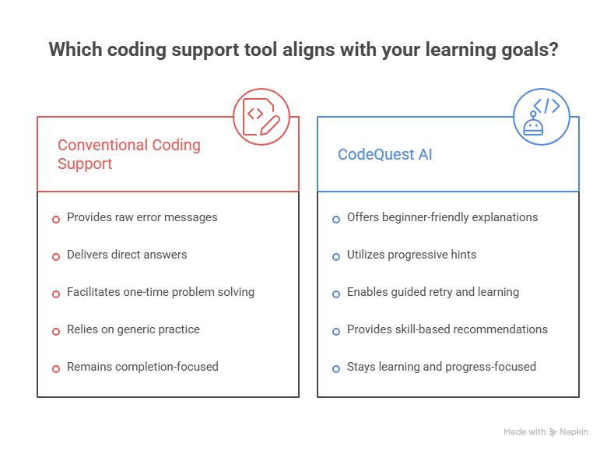
DIFFERENTIATOR
What Makes CodeQuest AI Different?
Learning over copying : Encourages learners to understand the reasoning behind a solution.
Progress through practice : Turns mistakes into opportunities to retry, reflect, and improve.
A path toward independence : Aims to help students solve future problems with greater confidence.
Our Differentiator: A challenge-driven coding experience that prioritizes understanding, independent debugging, and continuous improvement.
Help learners discover the answer — not simply receive it.

Slide 8










THANK YOU!
Game’s
Still On
VORTEXA 3.0
AIRS

